Slide 1
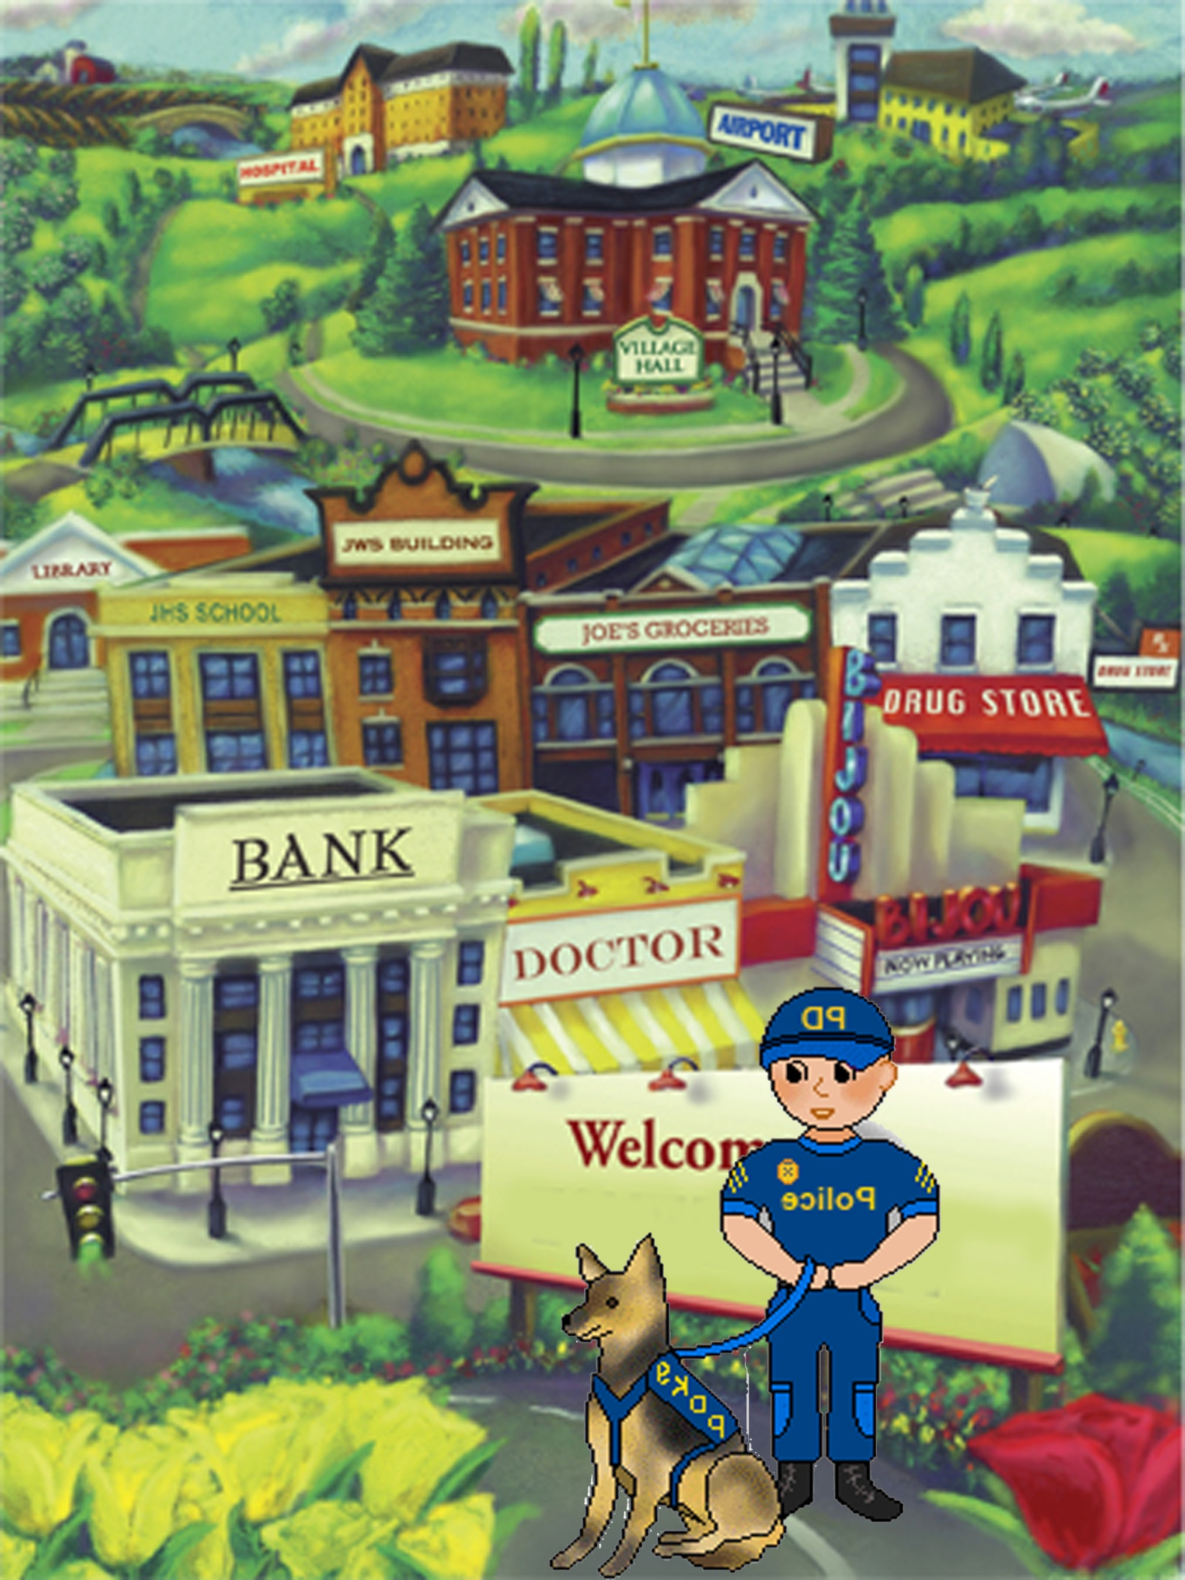
Cop Bob and Bud

Slide 2
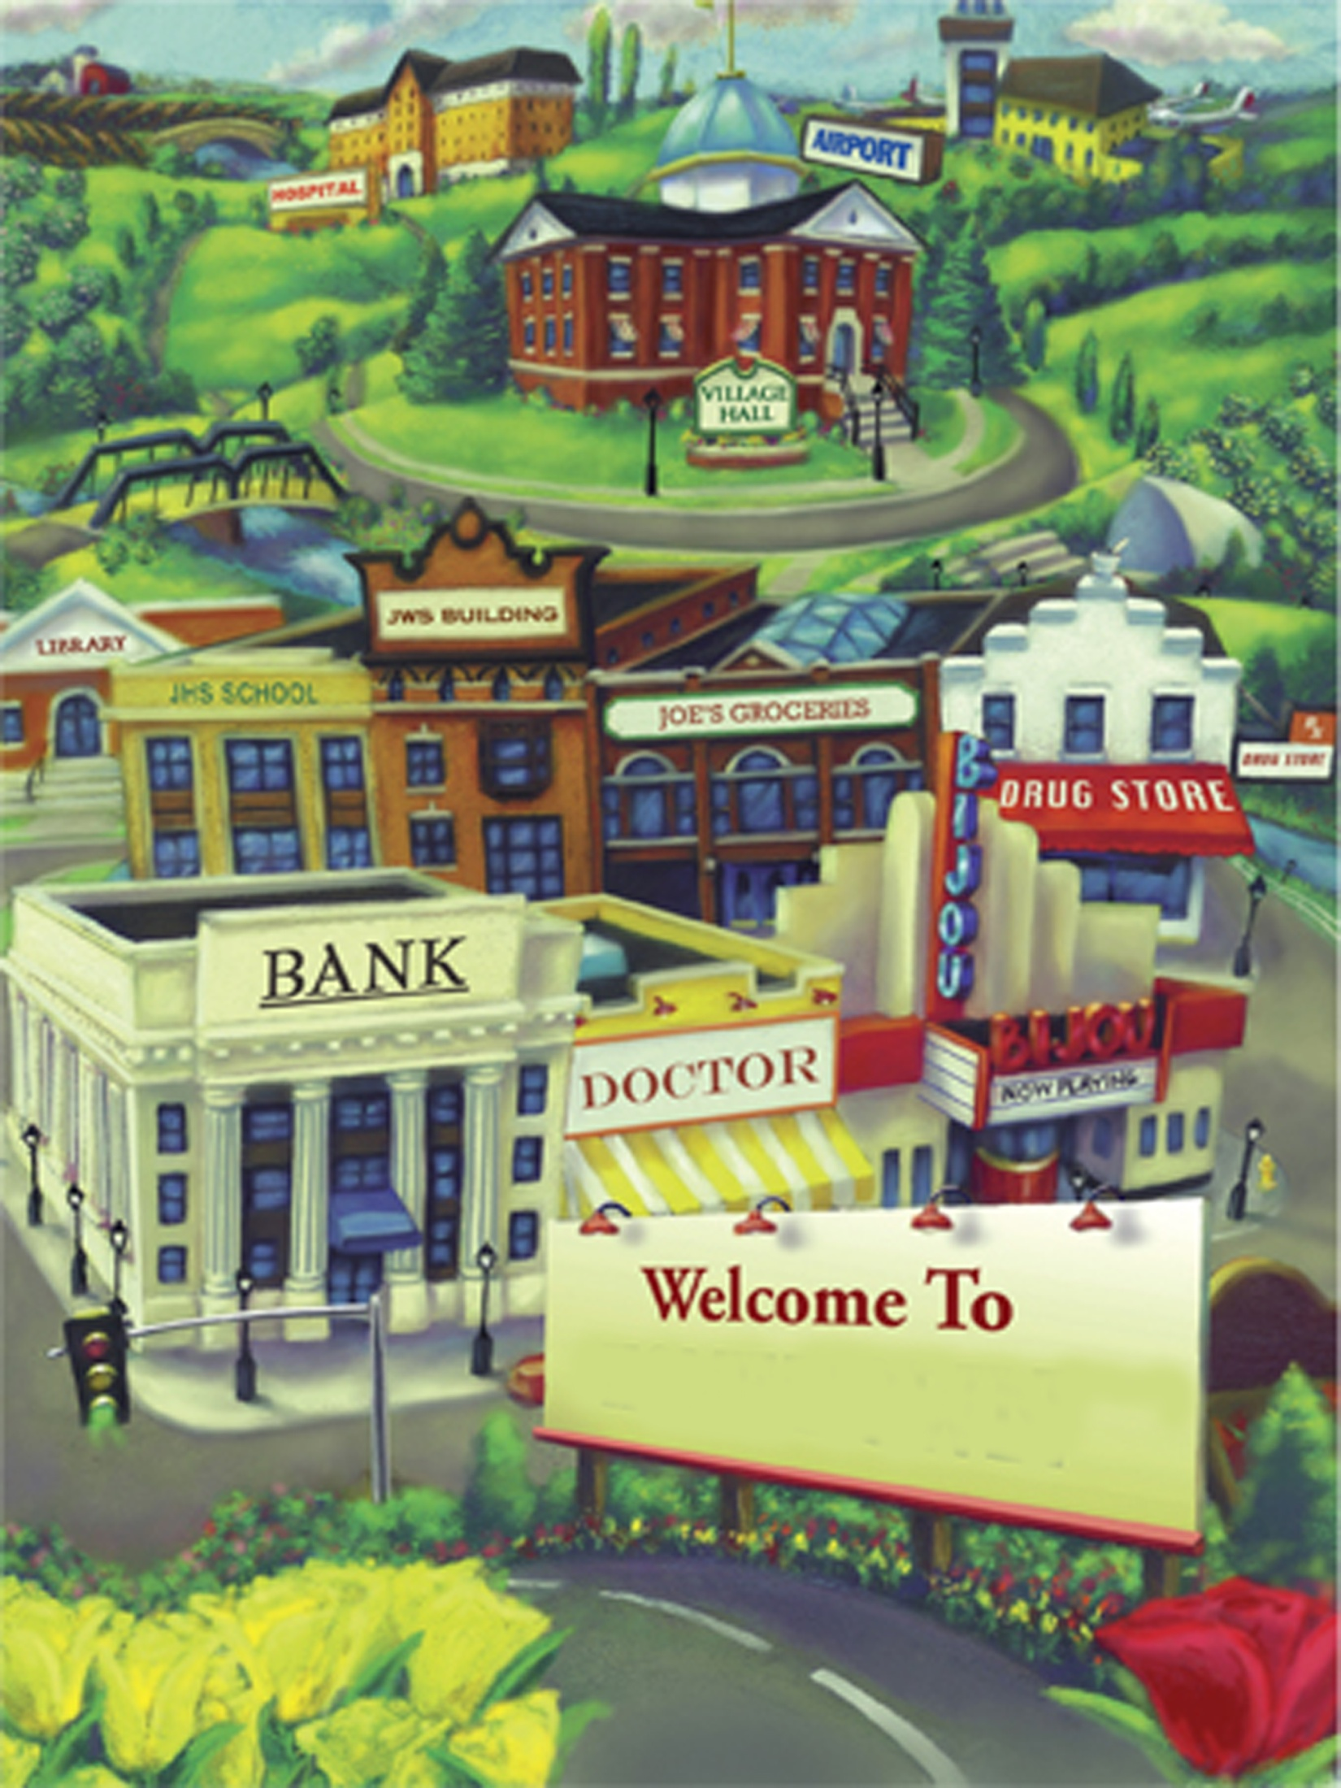
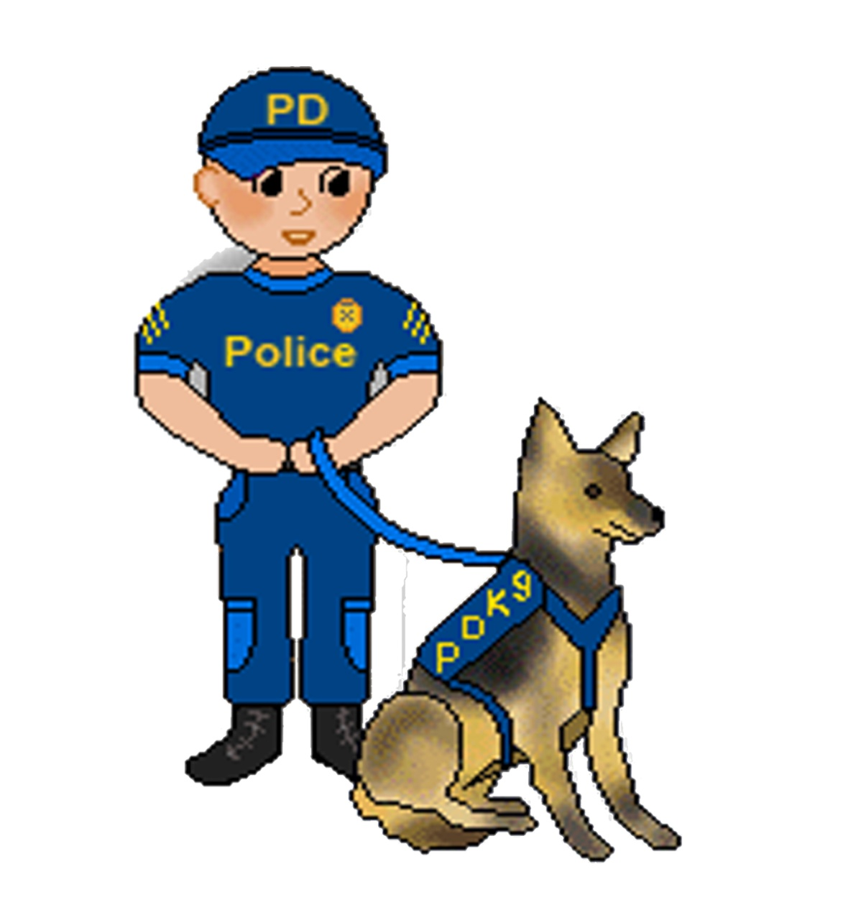
This is Bob. Bob is a Cop. Bob has a dog.

Slide 3
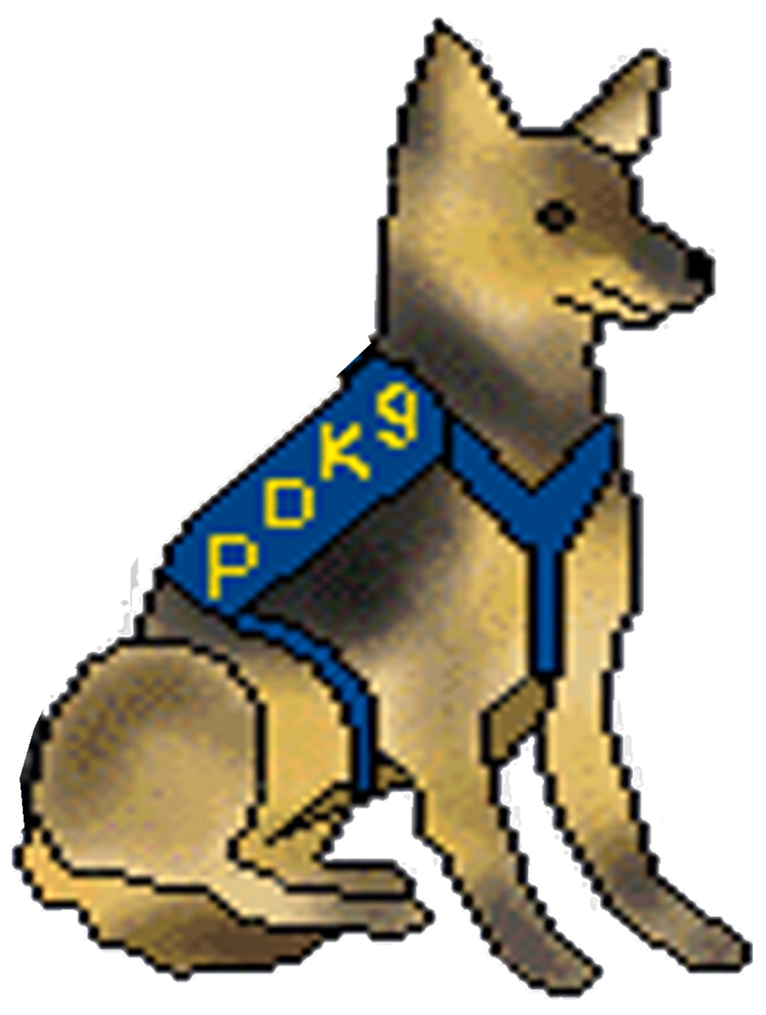
Bob’s dog is a cop dog. The dog’s name is Bud.

Slide 4
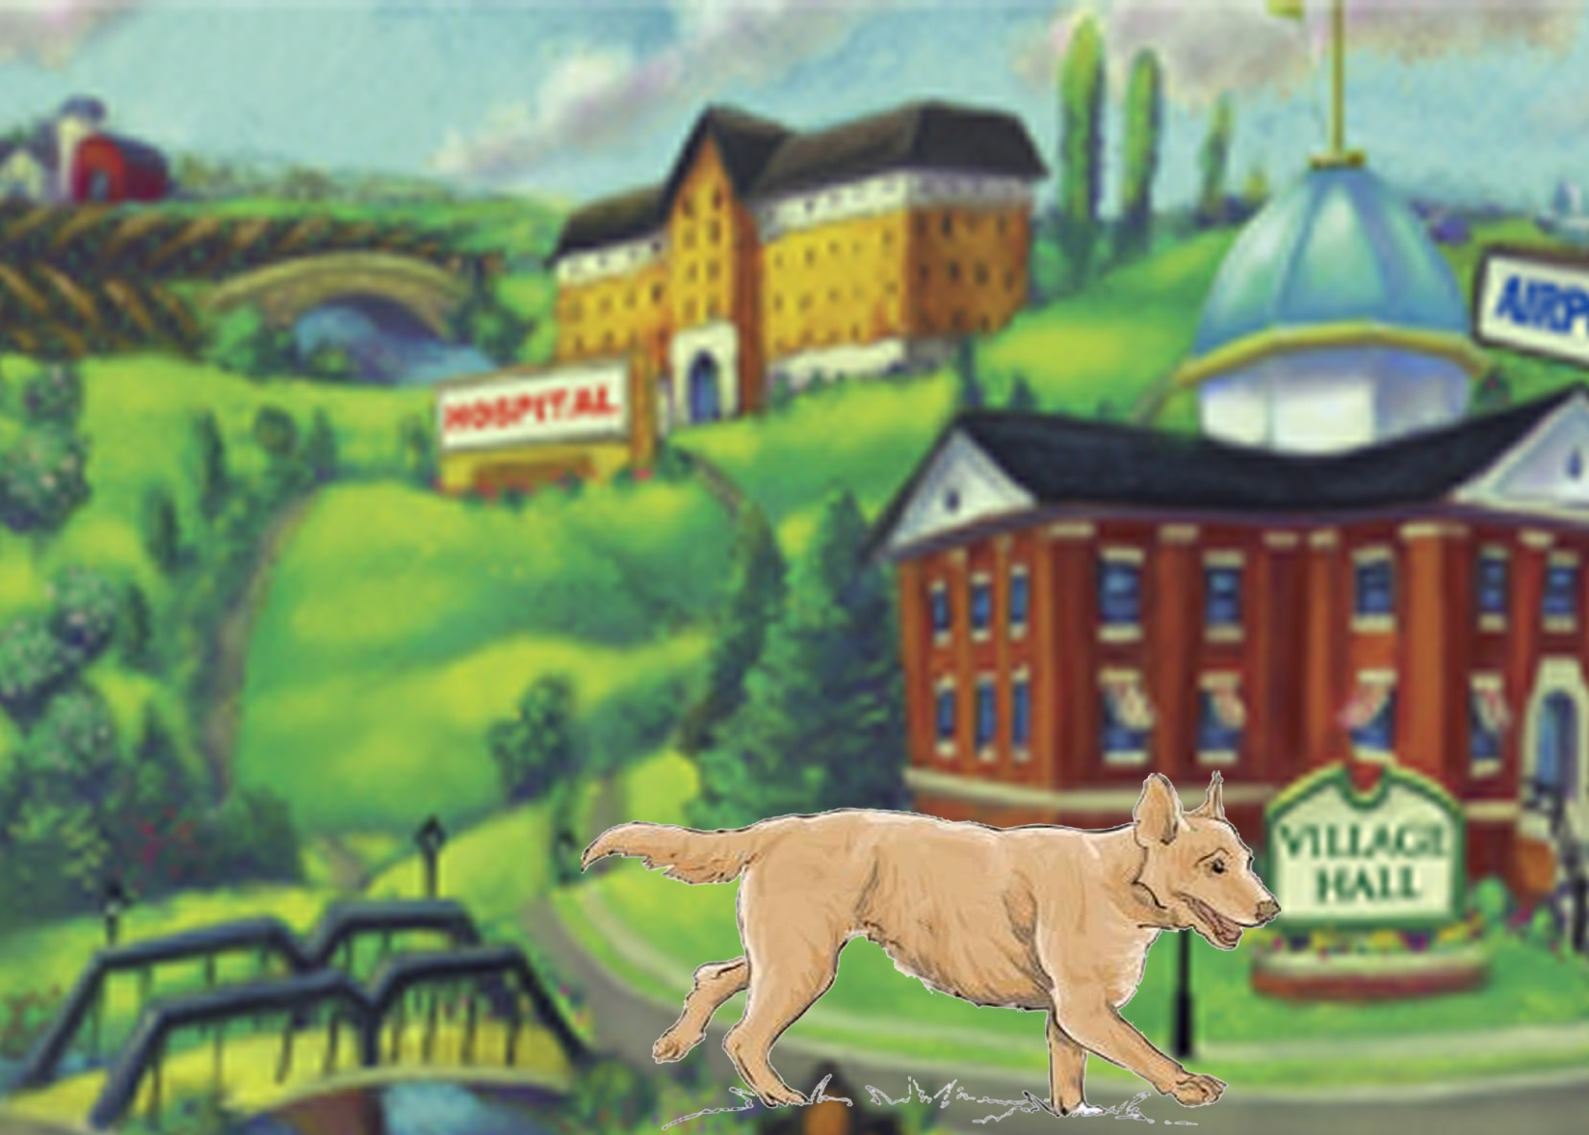
Bud likes to run.
Bud can run fast.
He likes to chase things.

Slide 5
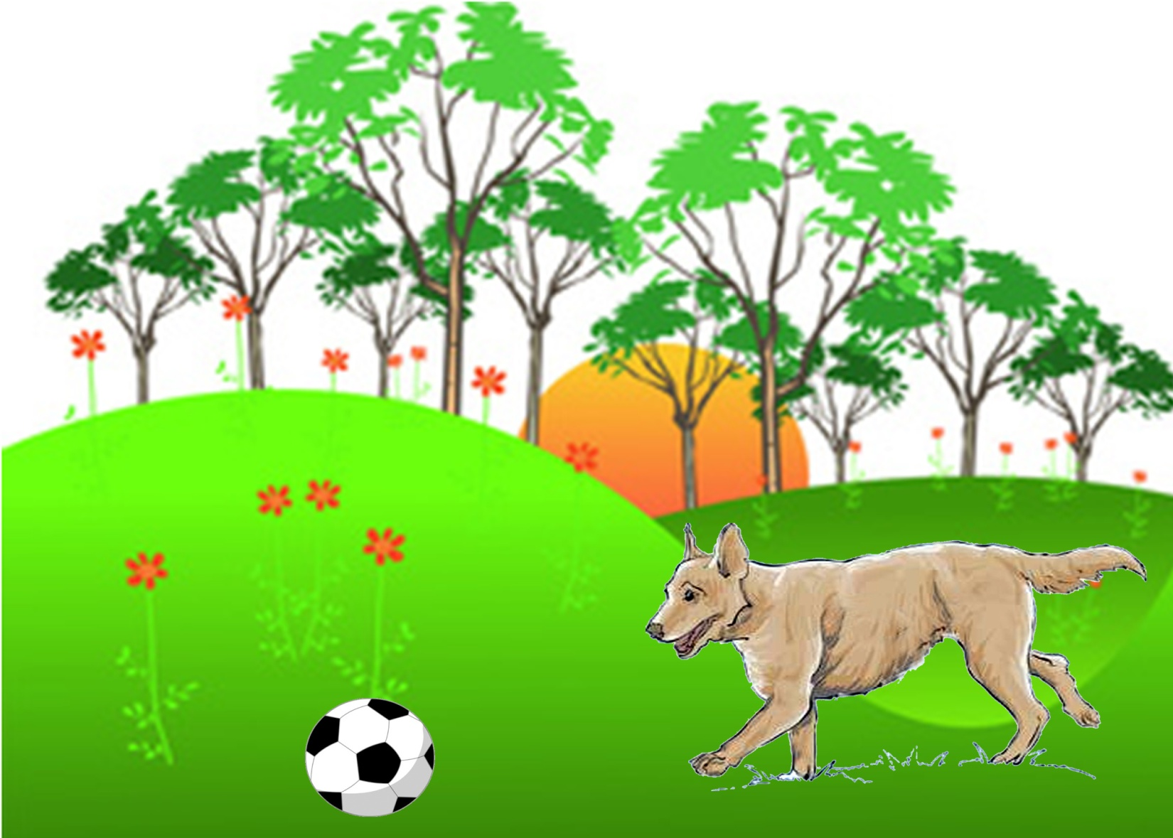
Bud likes to chase a ball.

Slide 6
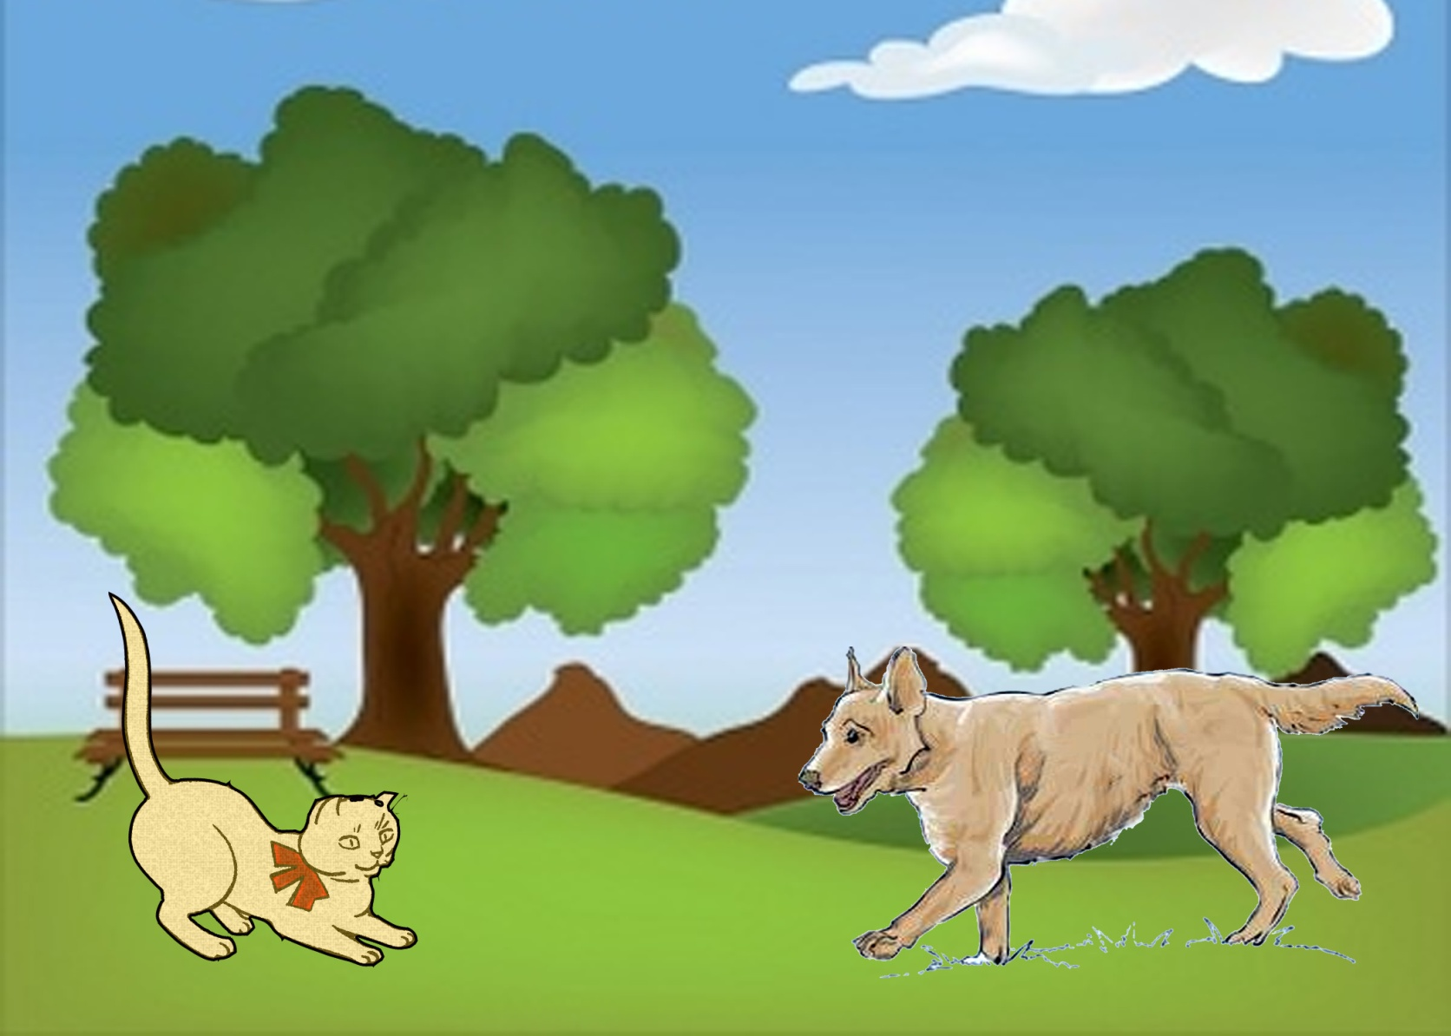
Bud likes to chase cats.

Slide 7
Bud likes to help Cop Bob.

Slide 8
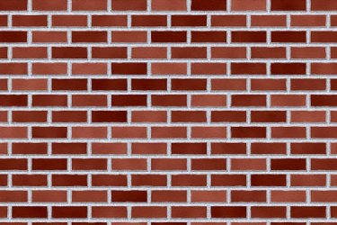
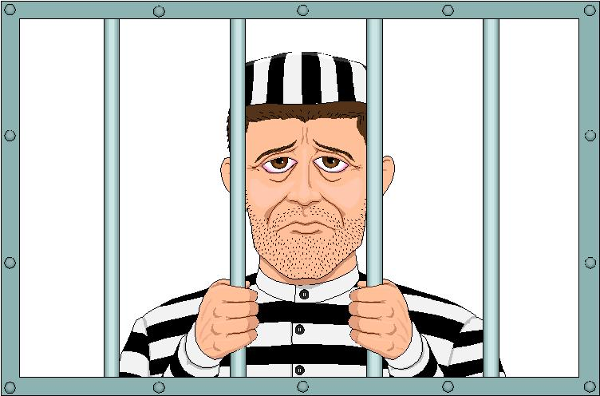
Bud helps Cop Bob at work.
Bud helps Bob stop crime.

Slide 9
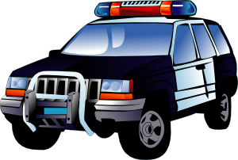
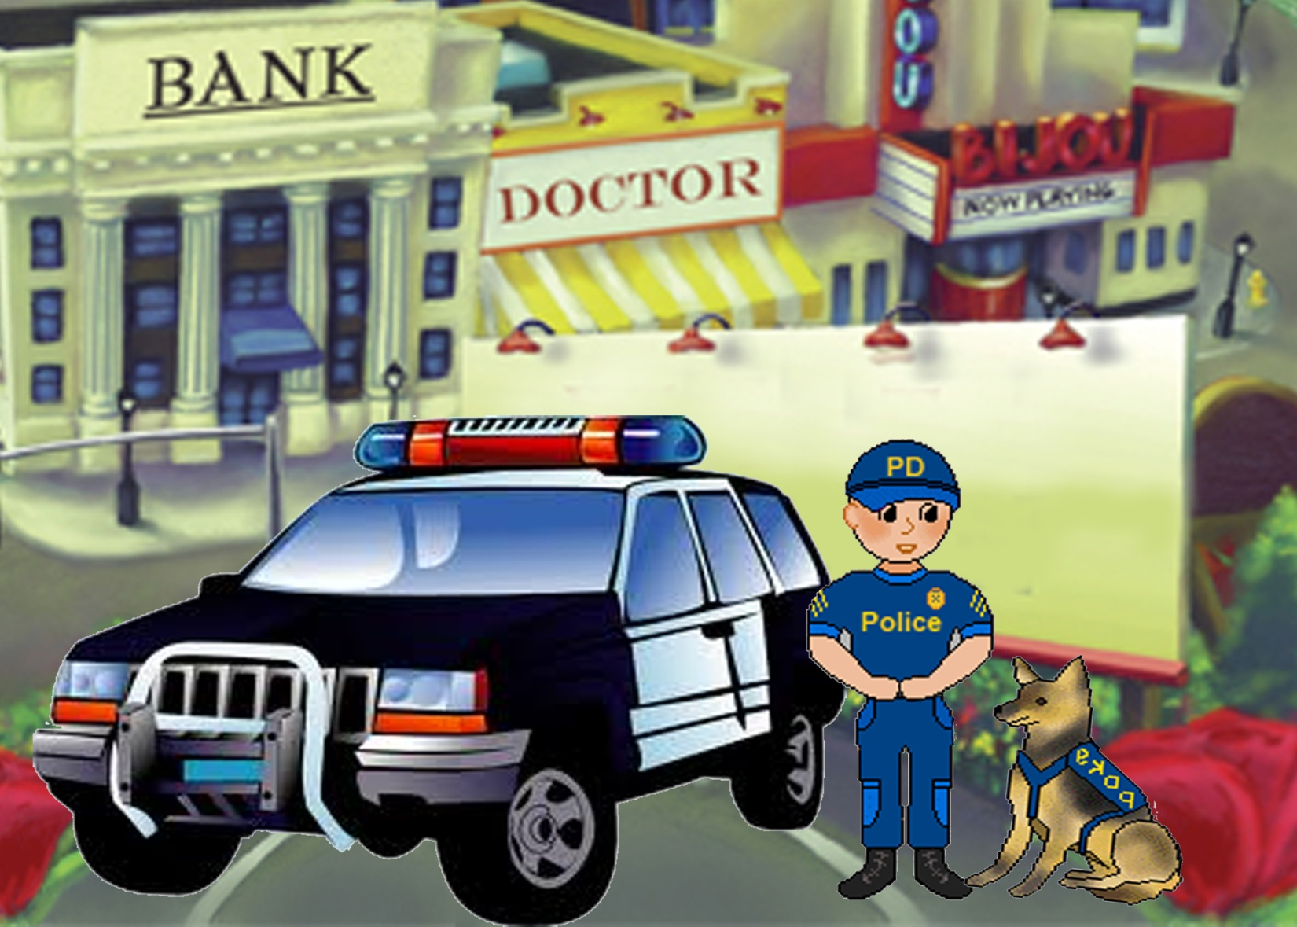
Bob is a good cop.
Bud is a good dog.
Bob and Bud like to help.

