Slide 1
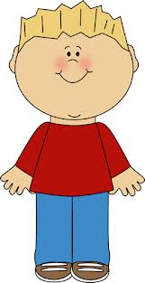
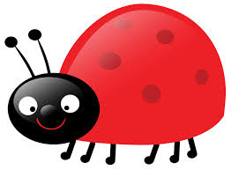
Ben and the Bug
By: Catie Dennis

Slide 2
Ben has a pet. Ben’s pet is a bug. The bug is big.

Slide 3
The bug is red. It is Ben’s pal. Ben has fun with the bug.

Slide 4
Ben is in the mud. The bug is in the mud. Ben and the bug dig.

Slide 5
The sun is hot to Ben. Ben and the bug go to Ben’s hut. The bug runs on the rug.

Slide 6
The bug puts mud on the rug. Ben’s dad is mad. Ben and the Bug are sad.

Slide 7
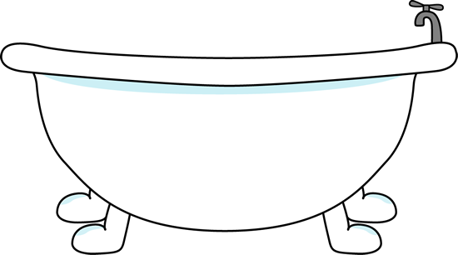
The bug is put in the tub. The bug got wet. Ben is glad.

Slide 8
Ben pets the bug. The bug and Ben are pals. Ben had fun with the bug.

Slide 9
The End Dr. Bruce Murray Decodable Book

