Slide 1
Dan and his Pals
By Sarah Price

Slide 2
This is Dan the dog.
Dan lives on a ranch.

Slide 3
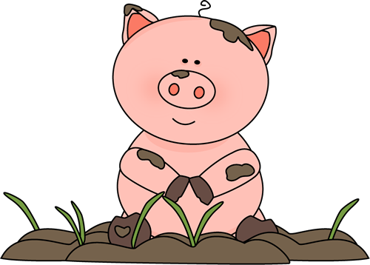
Dan runs at the ranch.
Dan runs to Pal the pig.
Pal is in the mud.

Slide 4
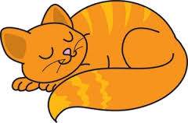
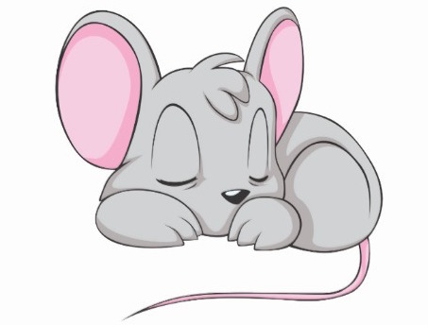
Dan runs from Pal and the mud.
Dan runs to Cas the cat.
Cas naps with a rat.

Slide 5
Dan runs from Cas. He runs to Doc the duck.
Doc swims in the pond.

Slide 6
Dan spots an egg.

Slide 7
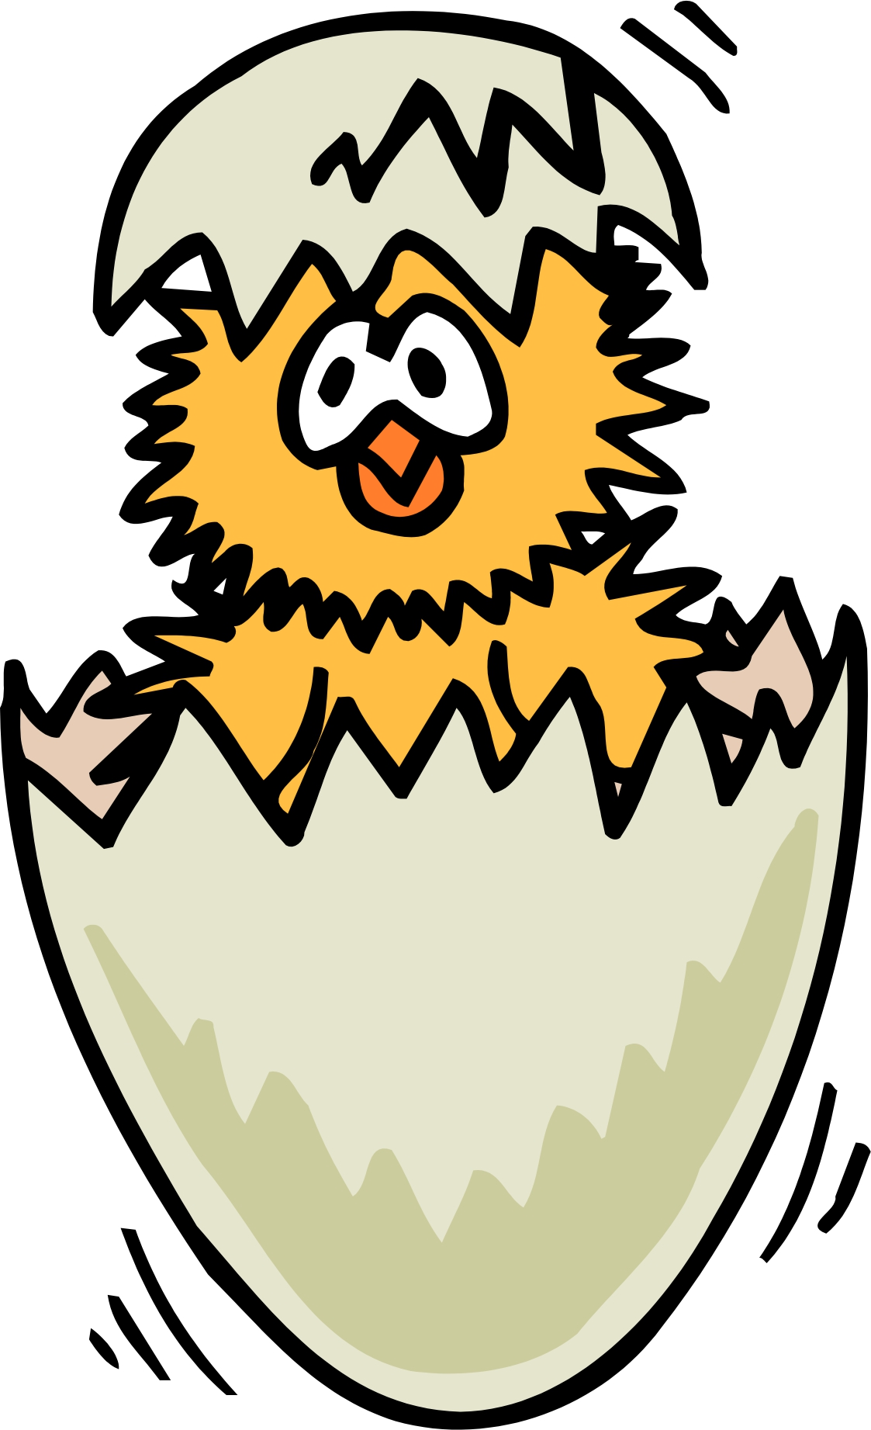
The egg cracks. It is a chick!

Slide 8
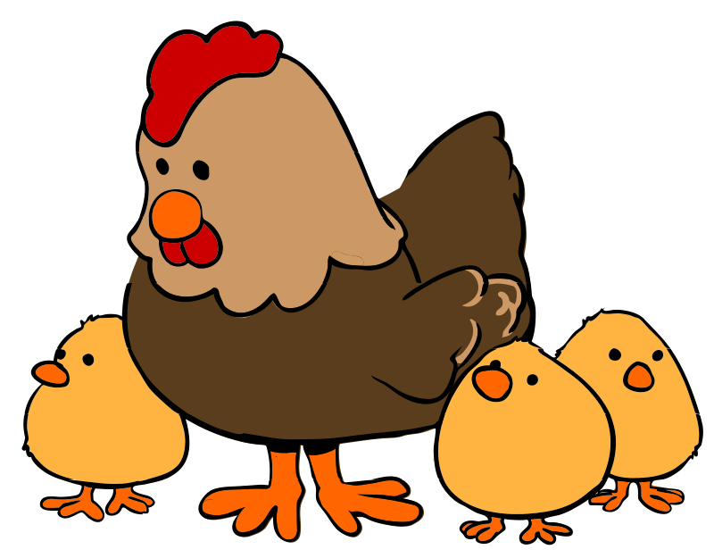
Chip the chick runs to the hen.
Dan has a new pal on the ranch.

