Slide 1

Fred’s Red Sled
By: Ameshia Cleveland
Spring 2016

Slide 2
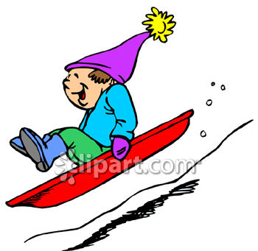
Fred gets dressed for fun in the sun.

Slide 3
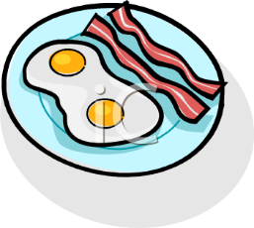
His mom will fix eggs.

Slide 4
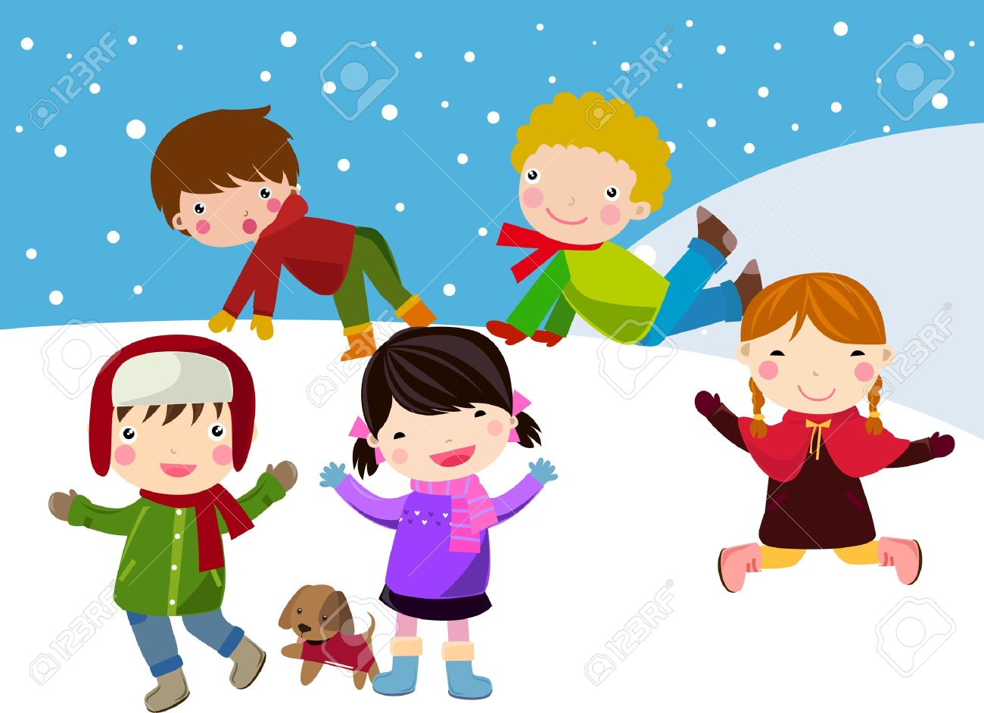
Before Fred’s fun in the sun, his mom tells him to have his sled next to him. Fred will have fun in the slick stuff with his pals.

Slide 5
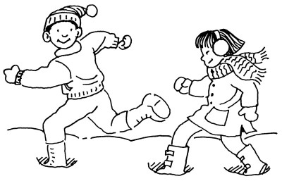
His pals want to run. Fred can run as well.

Slide 6

Fred did not have his sled next to him. He sat it by a stump.

Slide 7

Fred has to go back for lunch. He has to get his red sled.

Slide 8
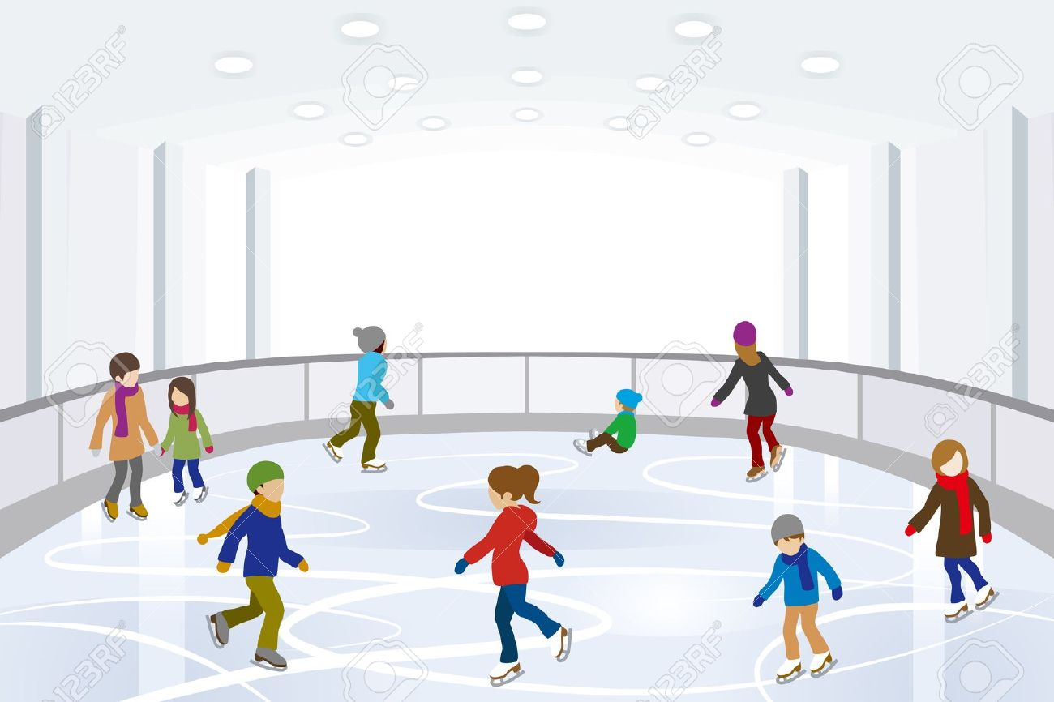
It is not by the stump where he left it. He ran to check for it at his rink, but it is not there.

Slide 9
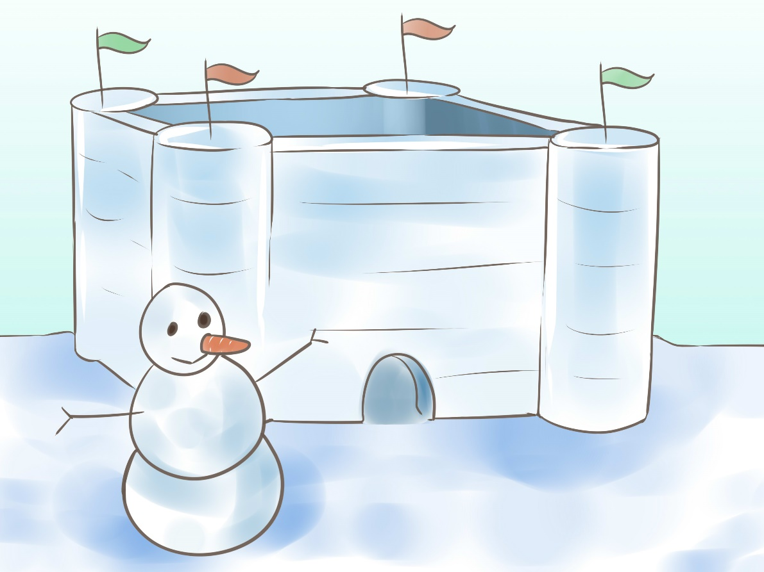
Fred is sad and sobs. He plans to jog back when he spots a man with red legs.

Slide 10
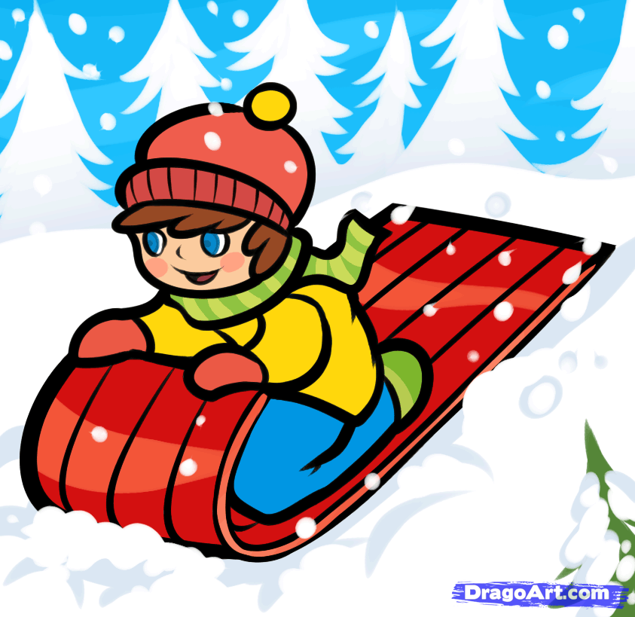
It is Fred’s red sled under the slick stuff. Fred is glad that he has his sled.

