Slide 1
Dance Class
By: Aaron Bush

Slide 2
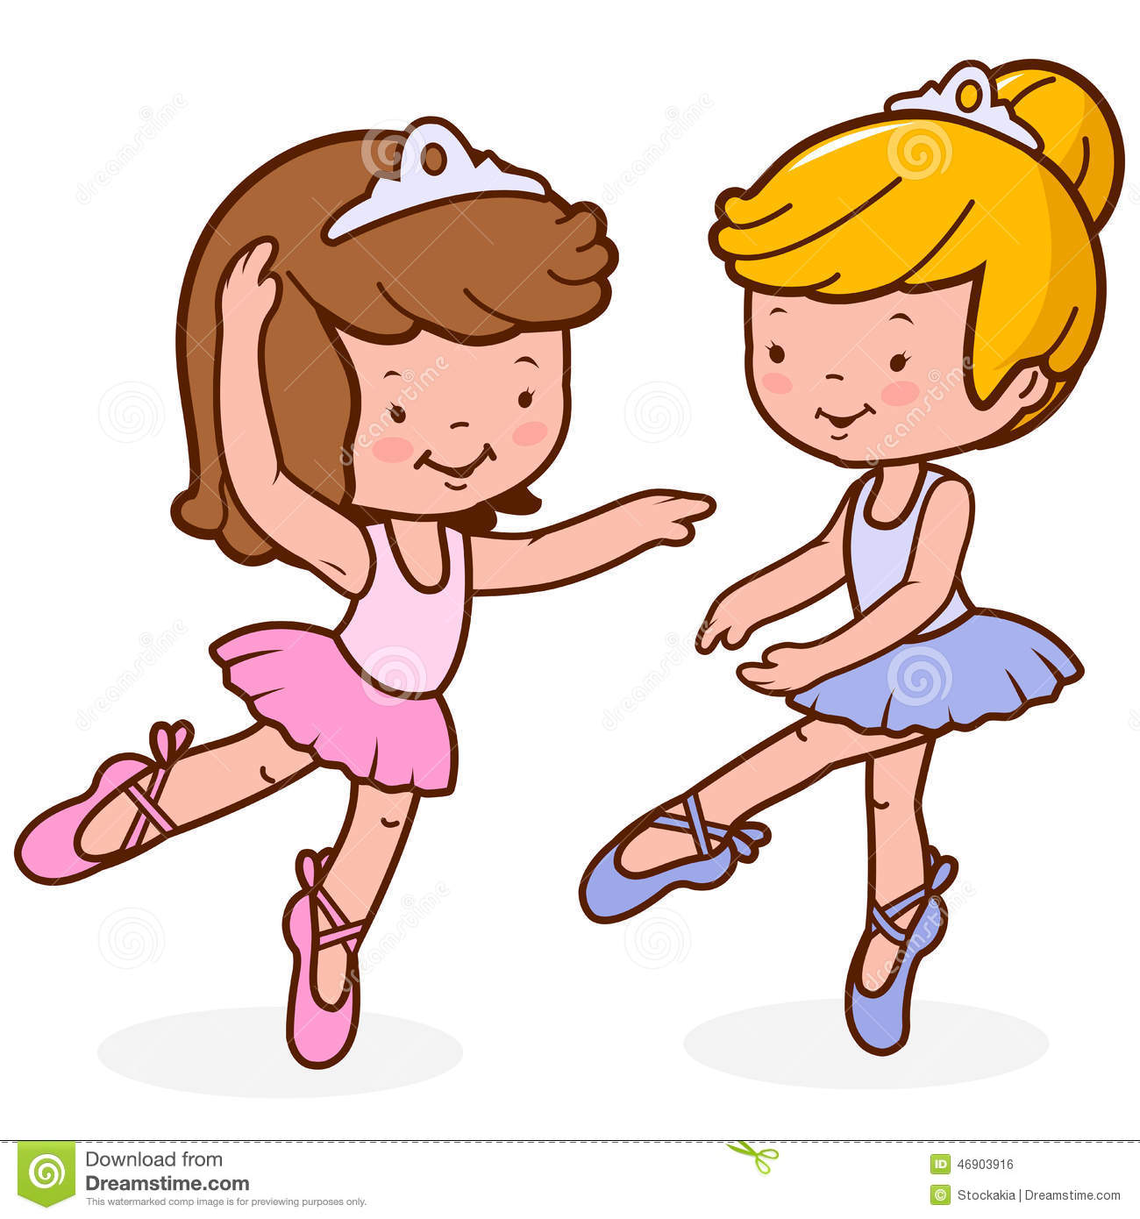
Jan and Sam are in a dance class.

Slide 3
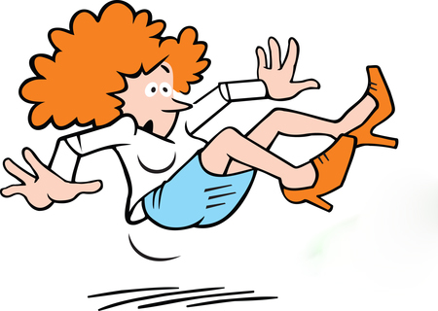
Jan fell when she did a spin.

Slide 4
The class gasps at the clash.

Slide 5
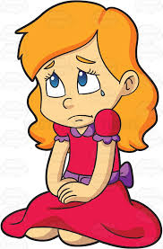
Jan is sad.

Slide 6
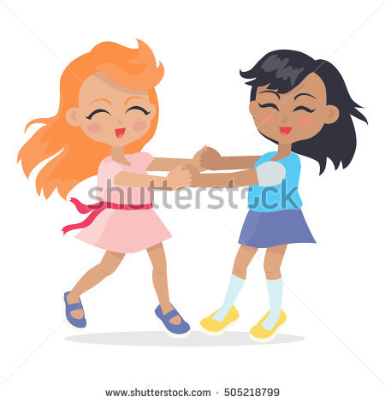
Sam had to catch Jan as she fell.

Slide 7
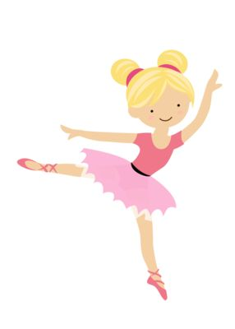
Jan got up at last.

Slide 8
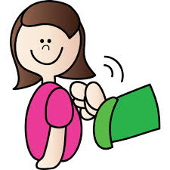
Sam pats Jan on the back.

Slide 9
They dance and spin.

Slide 10
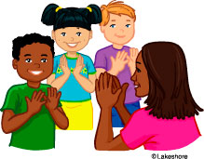
The class claps for Jan.

Slide 11
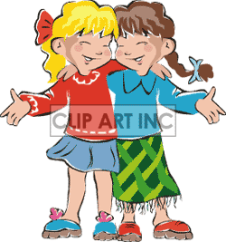
Jan and Sam are glad.

