Slide 1
Nat and Pam by Perry Steed

Slide 2
This is Nat.

Slide 3
This is Pam.

Slide 4
Pam is Nat’s mom.

Slide 5
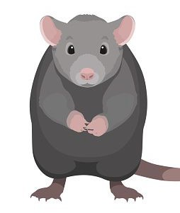
Nat has a pet rat.

Slide 6
Nat runs to her mom sad.

Slide 7
Pam asks, “are you sad?”

Slide 8
Nat lost her pet rat.

Slide 9
Pam gets mad.

Slide 10
Nat has a plan.

Slide 11
She gets the rat a snack.

Slide 12
The rat spots the snack!

Slide 13
The rat is back! Nat and Pam are glad.

Slide 14
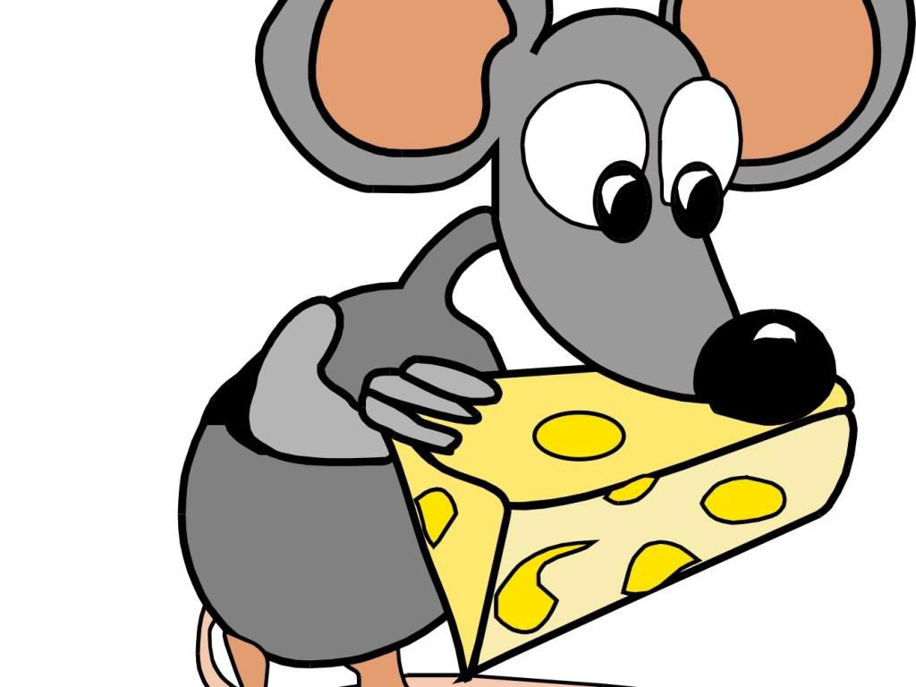
The snack does the trick!

Slide 15
The end!

