Slide 1
A Gift to Sing
By: Pierce Pruet

Slide 2
Trish is a pig. Her lot was that she had the gift to sing.

Slide 3
Trish had a plan to be an act in the art gig.

Slide 4
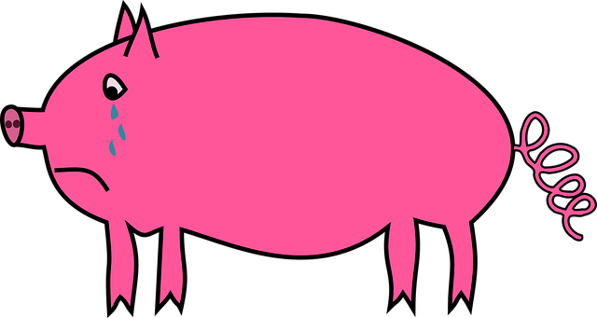
She is a wreck when her act is up.

Slide 5
A pal Ted clasps her in his best hug.

Slide 6
This stirs up her spunk. Trish can sing!

Slide 7
She has the nerve to sing.

Slide 8
Trish wins the big cup!

