Slide 1
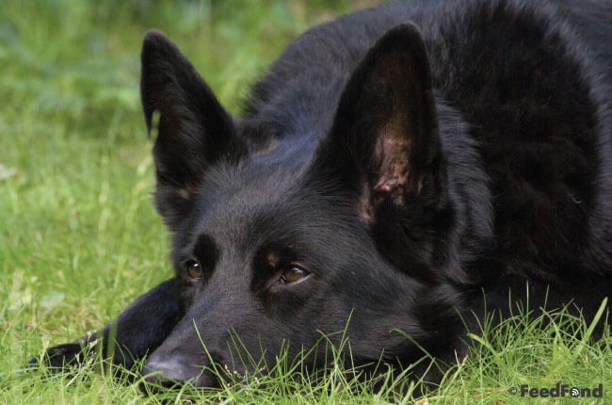
Max the Dog Gets Lost
By: Lauren Sistrunk

Slide 2
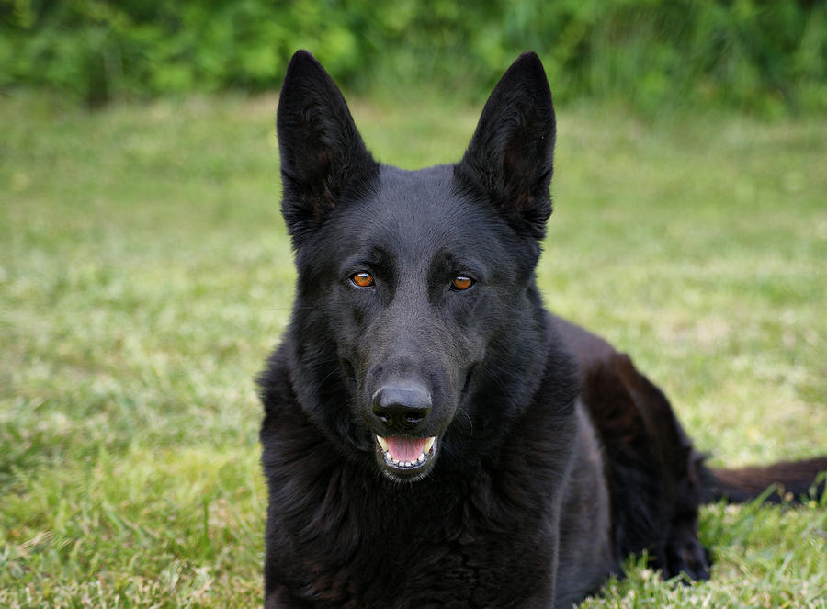
This dog is Max.
He is a big, black dog.
Max is the best pet.

Slide 3
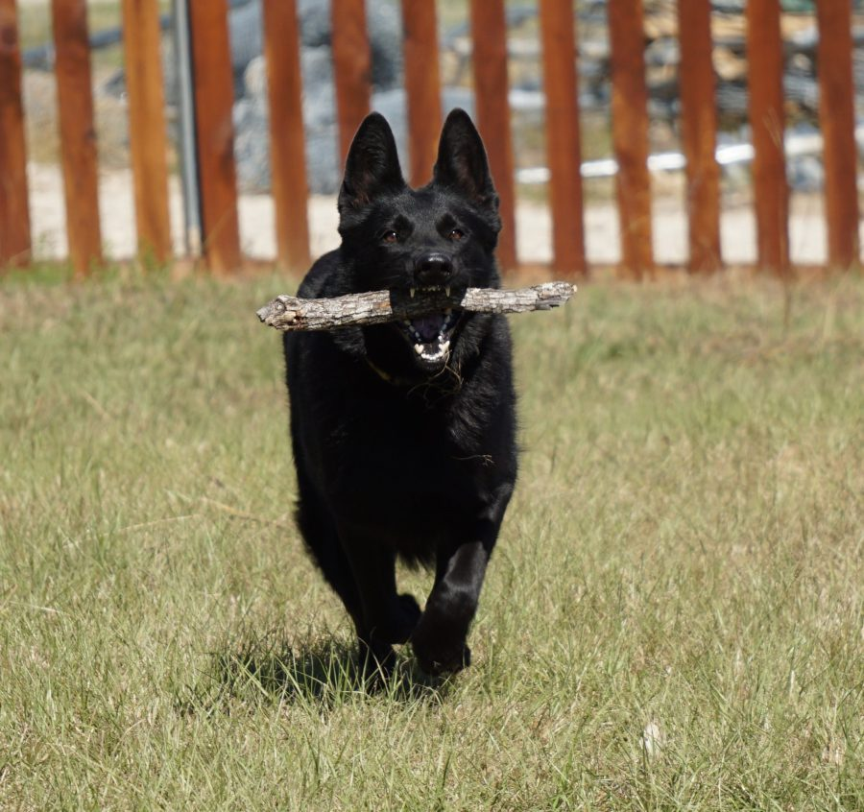
Max can run fast and jump.
He can fetch a stick or a twig.
He wags and licks.

Slide 4
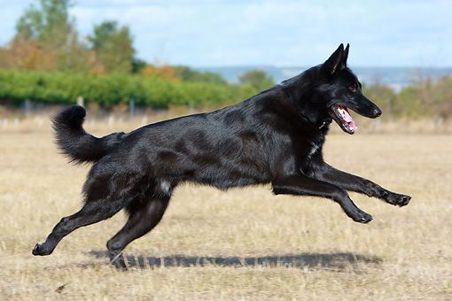
We skip in the grass in the sun.
Max runs fast. I yell ”stop!”
But Max gets lost. I yell “help!”

Slide 5
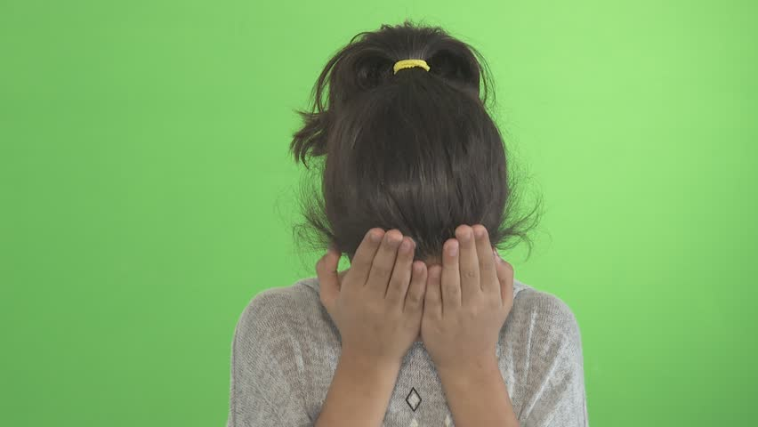
I get sad.
I miss Max.
I can not rest.

Slide 6
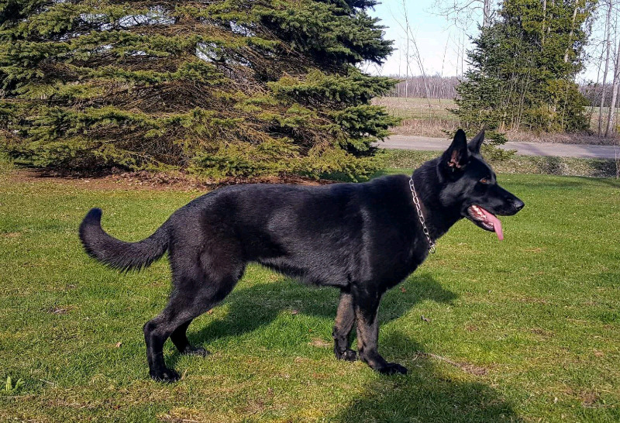
Fred grabs Max. He spots his tag.
Fred brings Max back.
I spring up. I yell “Max!”

Slide 7
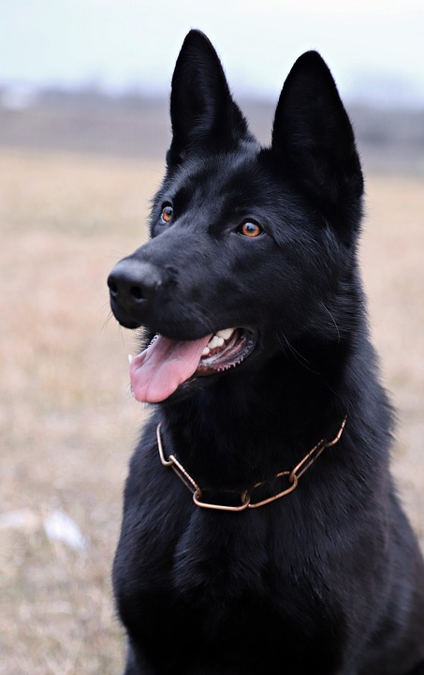
I hug Max.
I scratch his chest.
He licks and wags.

Slide 8
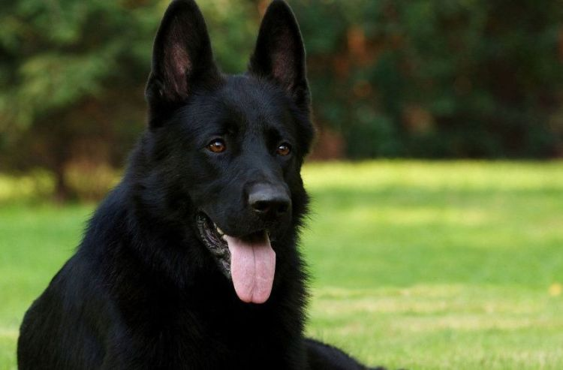
I am glad to have Max back.
I will not let Max get lost.
He is the best pup.

Slide 9
Picture Links:
https://www.feedfond.com/black-german-shepherd/
https://weheartit.com/entry/60619718
https://risingsk9.com/dog/nilla/
https://www.pinterest.com/pin/374150681529757702/
https://www.shutterstock.com/video/clip-12688205-girl-crying---young-female-kid-covers
https://puppiesforsaleontario.com/working-black-german-shepherd-puppies_ck-74730.html
https://pixabay.com/photos/black-german-shepherd-dog-portrait-3260427/
https://puppytoob.com/black-german-shepherd/

